Slide 1
Introduction To Azure Virtual Machines.
Tashik Moin MLSA, Microsoft. Tashik.Moin@StudentAmbassadors.Com
References Microsoft Ignite Microsoft Learn MSDN
Notes:
Good morning! I'm [ YOUR NAME ] and I'm absolutely thrilled to join you in [ CITY YOU ARE IN ].
Azure provides compute, storage and networking for the cloud
If you're new to Azure, or the cloud, it can be intimidating
This session will cover the essential concepts you'll need to get off and running with Azure networking

Slide 2
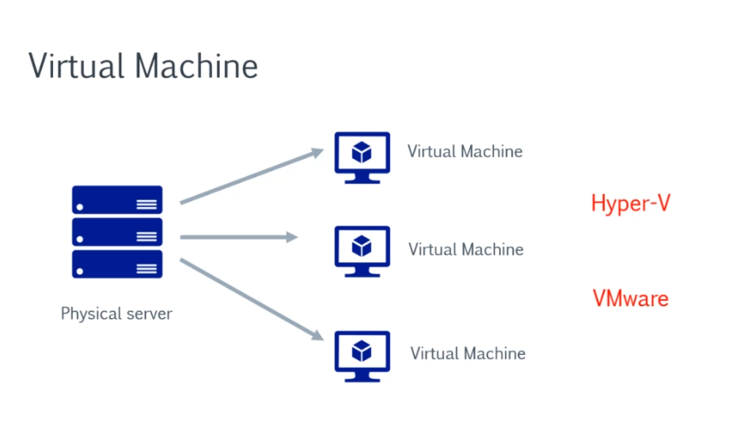

Slide 3
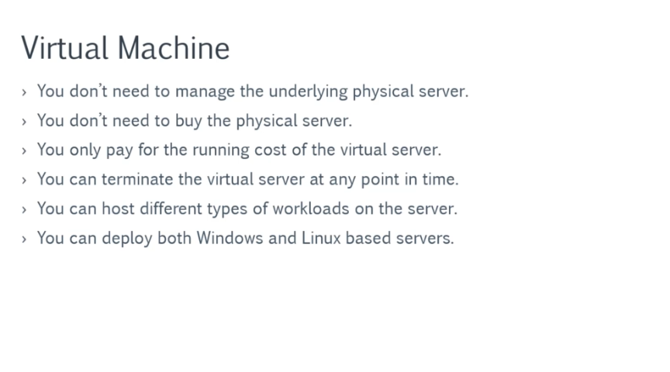

Slide 4
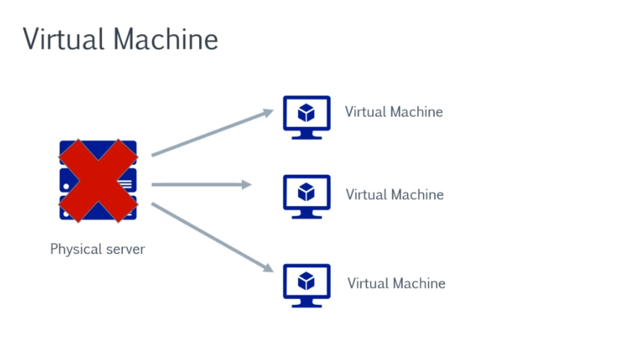

Slide 5
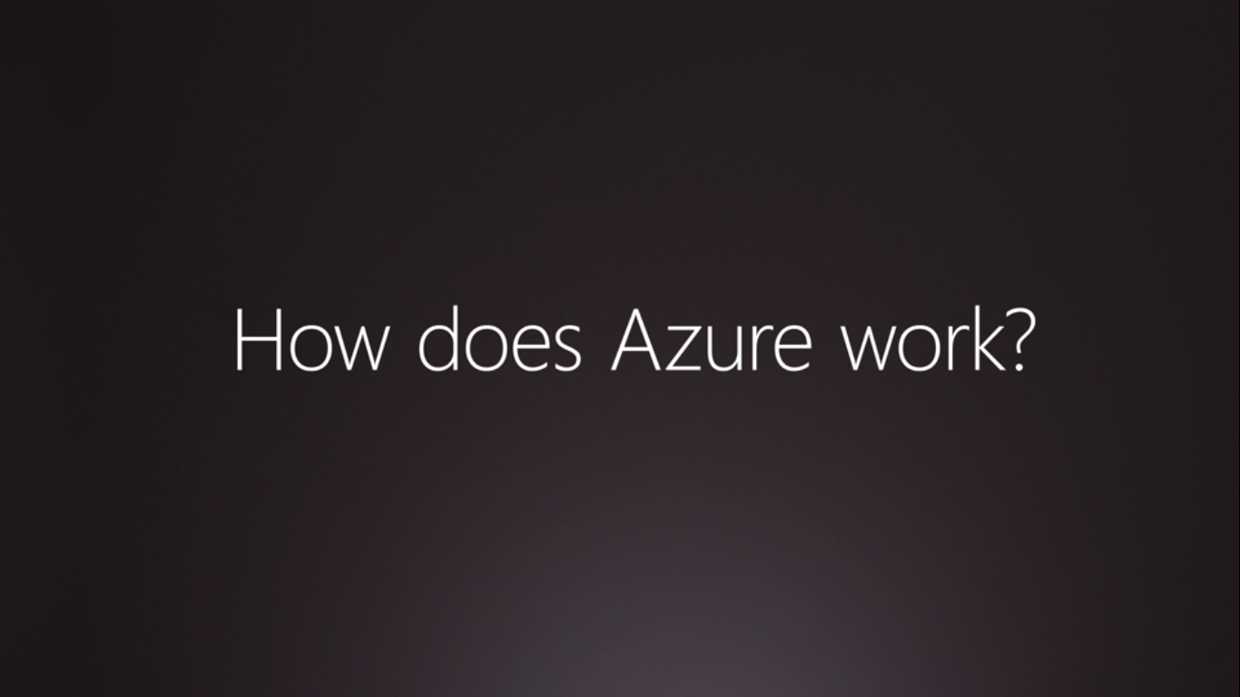

Slide 6
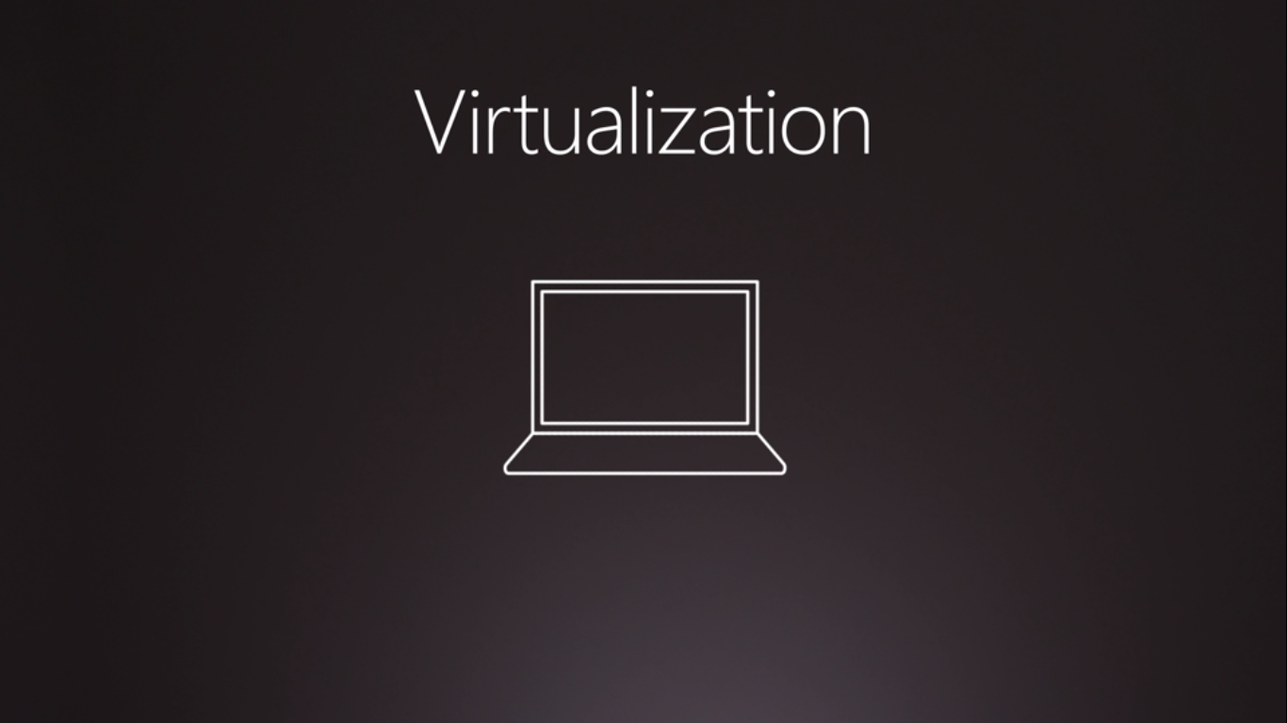

Slide 7
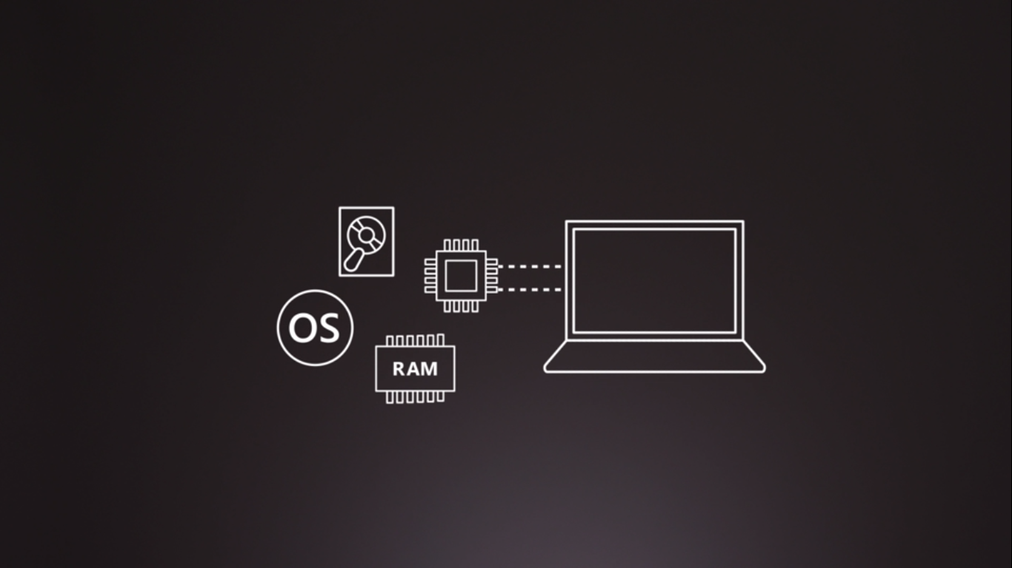
Introduction To Hypervisors

Slide 8
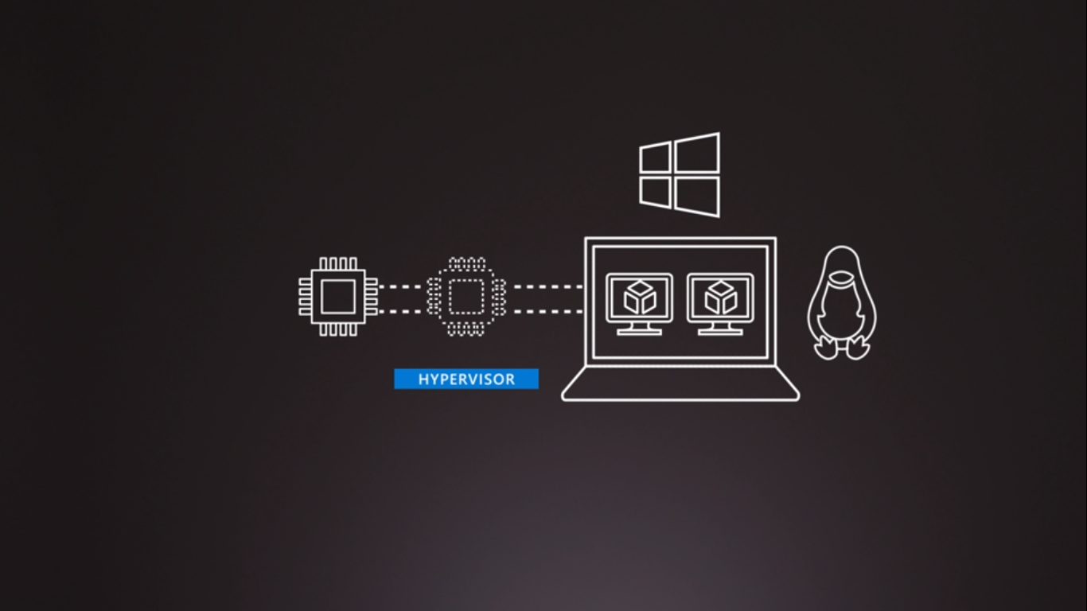
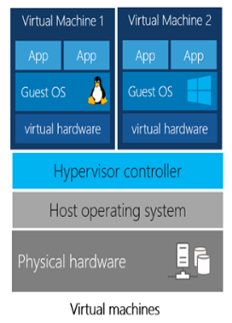
The Hypervisor Cont..

Slide 9
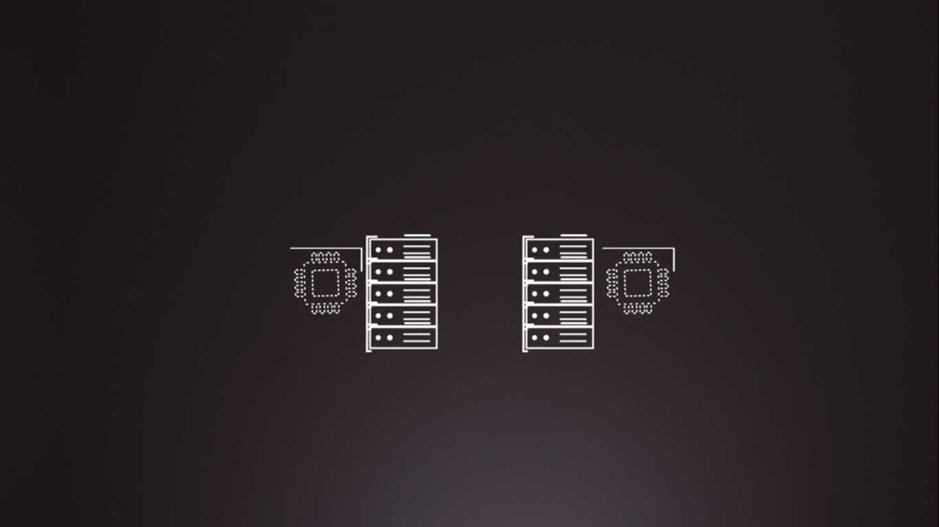
The Hypervisor Cont..
Each Server In Data Centers Includes A Hypervisor Software.
- Microsoft Azure Uses “Hyper V”, AWS Uses “Citrix XEN”, GCP Uses “KVM” & VMware Uses “Vsphere ESX & ESXI” As Their Hypervisor Software To Create Virtual Machines.
Hypervisor
Hypervisor

Slide 10
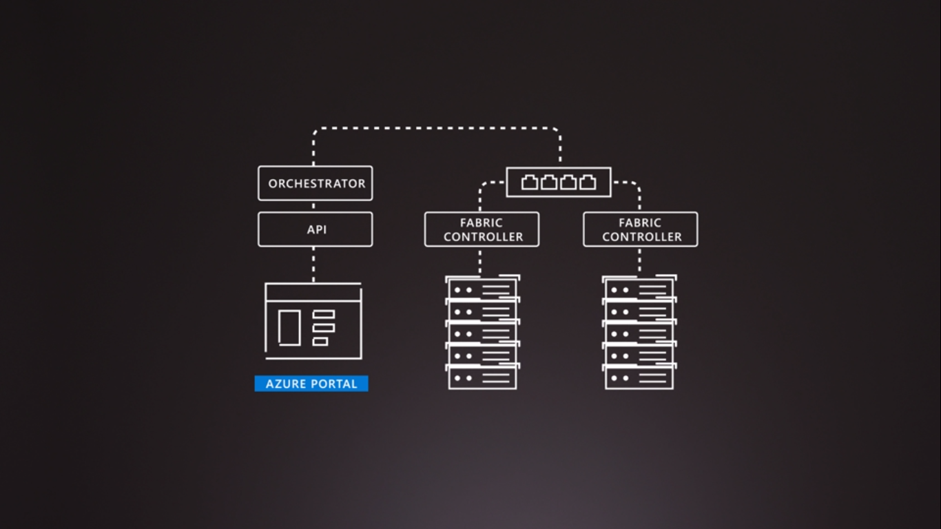
Every Rack Of Sever Is Connected With Switches & Has A Software Called Fabric Controller That Is Also Connected With Another Software Called Orchestrator. It Is The Responsibility Of The Orchestrator To Manage All The Requests Made From The Azure Portal.

Slide 11
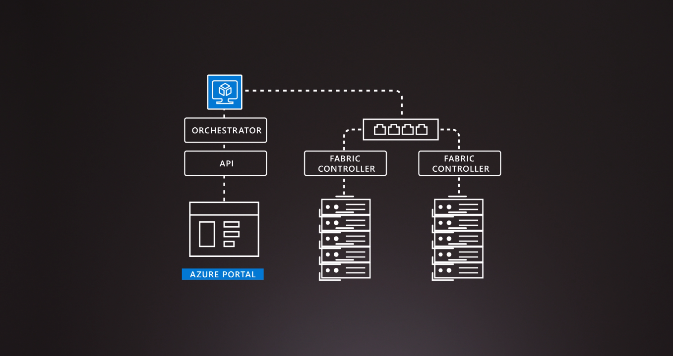
Orchestrator Receiving Request From Azure Portal

Slide 12
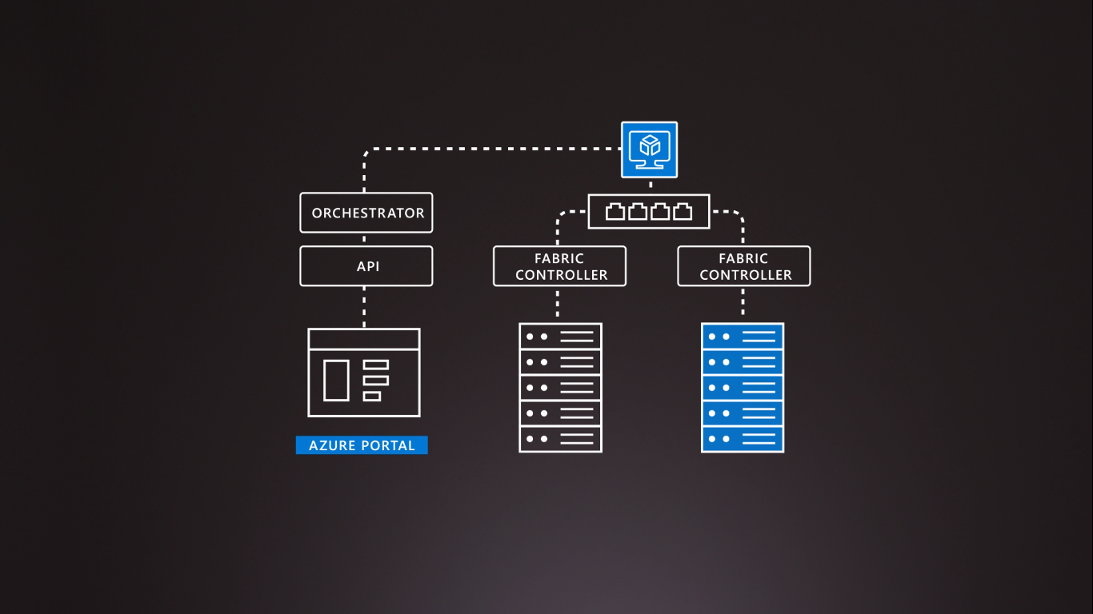
The Orchestrator Handles The Request From The Azure Portal & Allocates The Best Possible Server For The Given Request. The Fabric Controller Then Creates The Virtual Machines & Then The Users Are Allowed To Access Them Through A Remote Desktop.

Slide 13
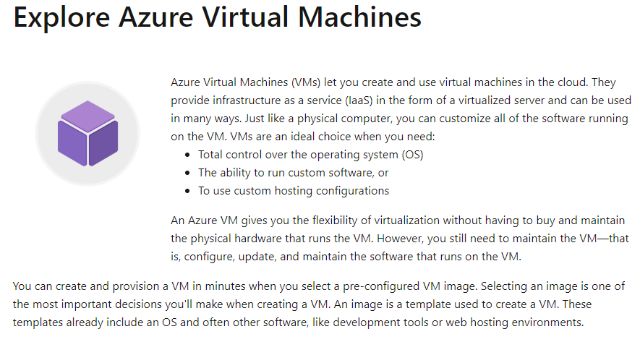

Slide 14
Examples Of When To Use Virtual Machines
During testing and development. VMs provide a quick and easy way to create different OS and application configurations. Test and development personnel can then easily delete the VMs when they no longer need them.
It is used to increase/reduce servers suppose if an application needs to handle fluctuations in demand, being able to shut down VMs when you don't need them or quickly start them up to meet a suddenly increased demand means you pay only for the resources you use.
During disaster recovery. If a primary datacenter fails, you can create VMs running on Azure to run your critical applications and then shut them down when the primary datacenter becomes operational again.

Slide 15
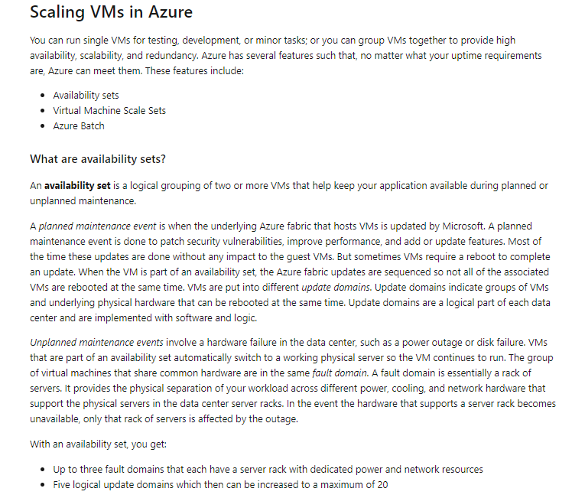

Slide 16
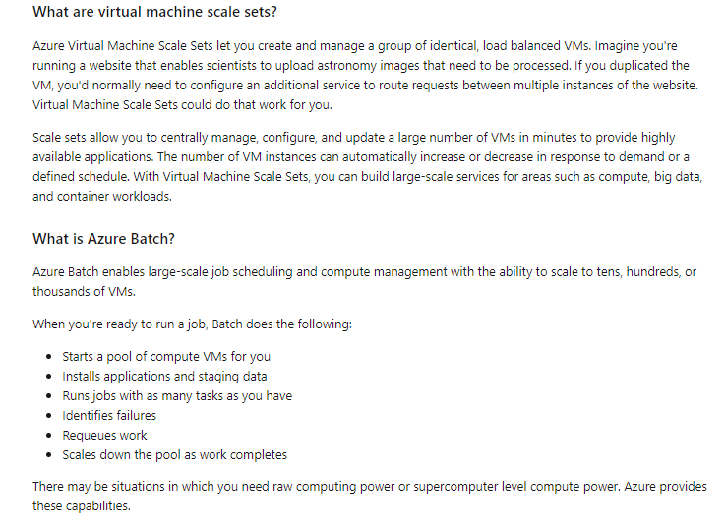

Slide 17
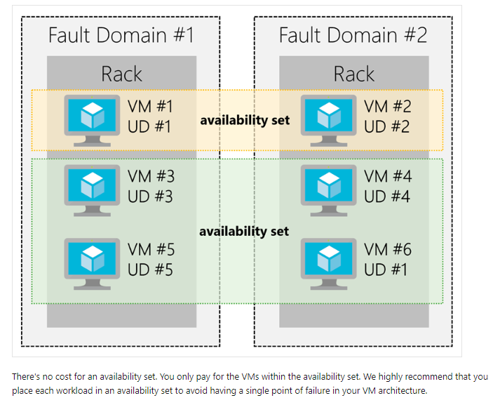

Slide 18
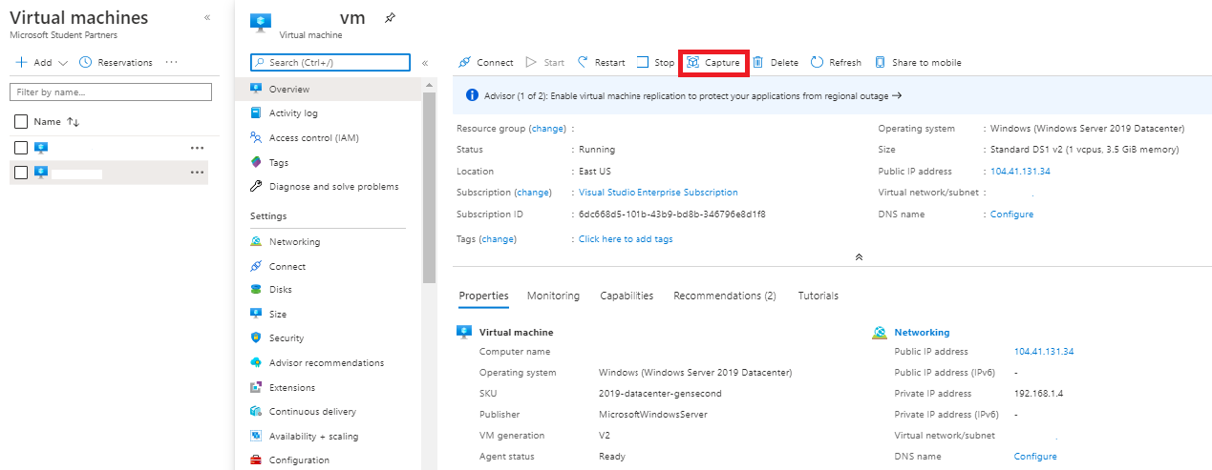

Slide 19
